Slide 1

Tahapan Proyek Pengembangan Perangkat Lunak
Otniel y. viktorisa

Slide 2
Tahapan Pengembangan
Planning
Requirements analysis/gathering
Design
Implementation
Testing
Production (Go-live)
Maintenance & support

Slide 3
Planning
Pembentukkan tim pengembang
Penentuan lingkup pengerjaan (scope of work)
Pemilihan metode dan strategi

Slide 4
Planning > Pembentukan tim pengembang
Project manager
Technical lead
Business analyst (functional)
Developer
UI/UX Designer
QA (tester)
Technical writer
Infrastructure engineer

Slide 5
Planning > Penentuan lingkup pengerjaan (scope of work)
New development/enhance/maintenance
Modules and features
Out of scope definition

Slide 6
Planning > Pemilihan metode dan strategi
Waterfall/scrum/kanban
Progress report
etc

Slide 7
Requirements analysis/gathering
Who : client (users, business analyst), development team (business analyst, technical lead)
What : functional specification document
How : in-depth discussion

Slide 8
Design
UI & UX design
Database design
Architecture design
Infrastructure design

Slide 9
Implementation
Coding
Coding
Coding
Unit test

Slide 10
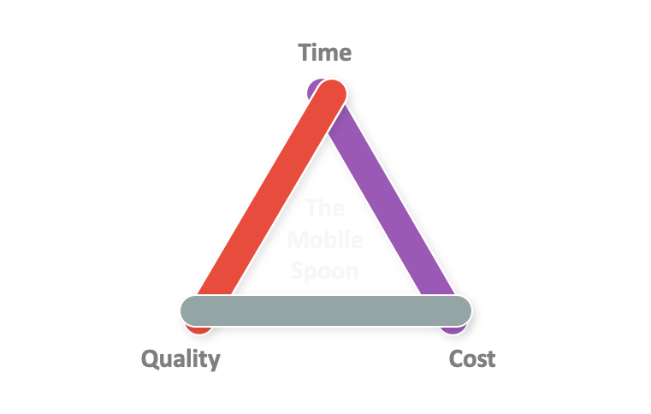
Implementation

Slide 11
Testing
Integration test
Regression test
Penetration test
Stress/performance test
User acceptance test

Slide 12
Production (go-live)
Deployment to production environment
Data migration
User training

Slide 13
Maintenance & support
Bug fixing
Issue support

